Slide 1
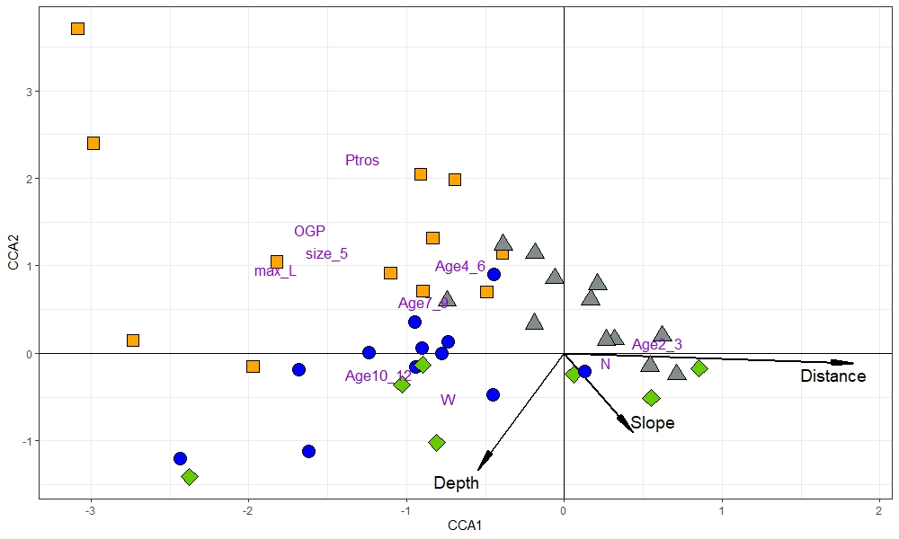
rocky littoral
ПП: Fig. Canonical correspondence analysis (CCA) diagram showing the relationships between demographic and taxonomic parameters of mussel settlements on the one hand, and their environmental parameters, on the other, in 2009-2010. CCA1 explains ??%, CCA2 - ?? % of the canonical variance. Each sign represent mussel settlement, settlements from the kelp forests, rocky littoral, sandbanks, and from the mussel bank are shown with signs of different form and color. Each text mark represent demographic and taxonomic parameter. Insignificant (p>0.0??) environmental constrains are omitted, significant are represented by arrows where direction and length of arrows shows the degree of correlation between environmental constrains and demographic and taxonomic parameters.
littoral sandbanks
mussel bed
kelp
forests
Я: Fig. . The relationship between demographic, taxonomic? and environmental parameters of mussel settlements in 2009-2010 visualized by CCA. Ordination in constrained axes with type III (symmetric) scaling is shown. Each point represent individual mussel settlement, colors and shapes of point correspond to characteristic mussel habitats (see legend), text markers - demographic and taxonomic parameters. Environmental constrains are represented by arrows. The longer the arrow, the greater the influence of the environmental parameter.
ВМ: Fig.Symmetrically scaled Canonical correspondence analysis (CCA) of mussel populations described in terms of demographic and taxonomic parameters in 2009-2010. CCA1 explains 36.5%, CCA2 - 9.6 % of the total inertia. Shape and color of points indicate mussel settlement’s type (kelp forests, rocky littoral, sandbanks and mussel bed). Text markers represent demographic and taxonomic parameters. Arrows indicate invironmental constrains (direction and length of arrows shows the degree of association between canonical axes and environmental constrains).

Slide 2
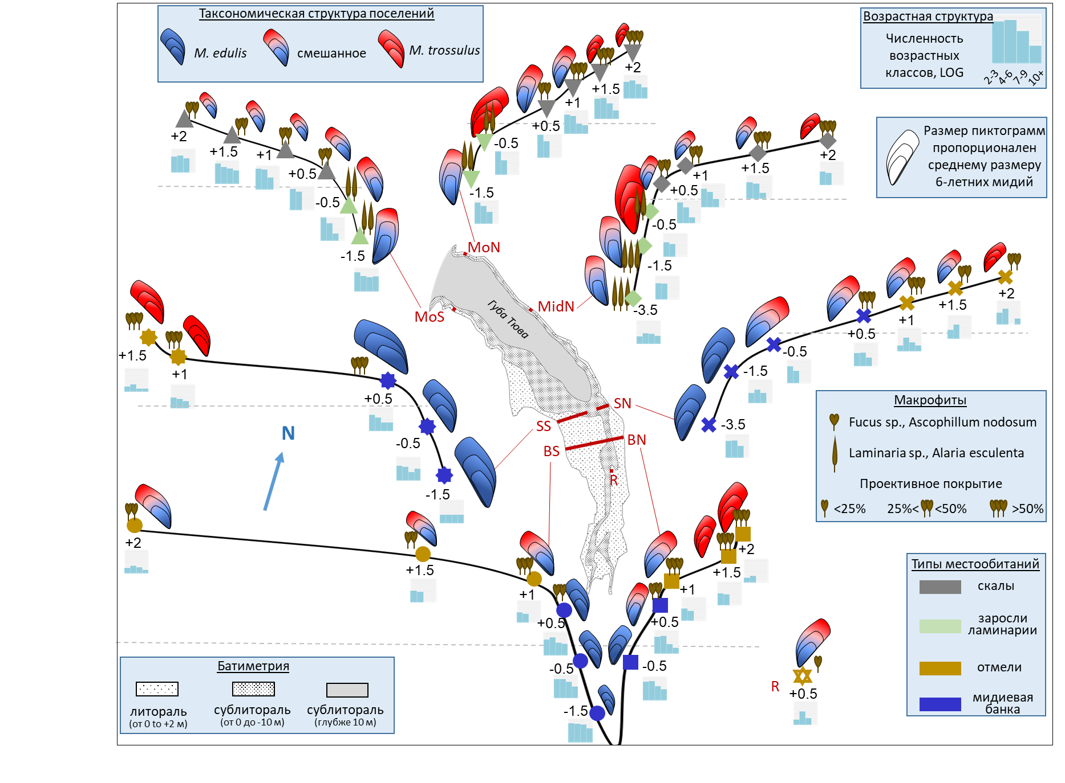
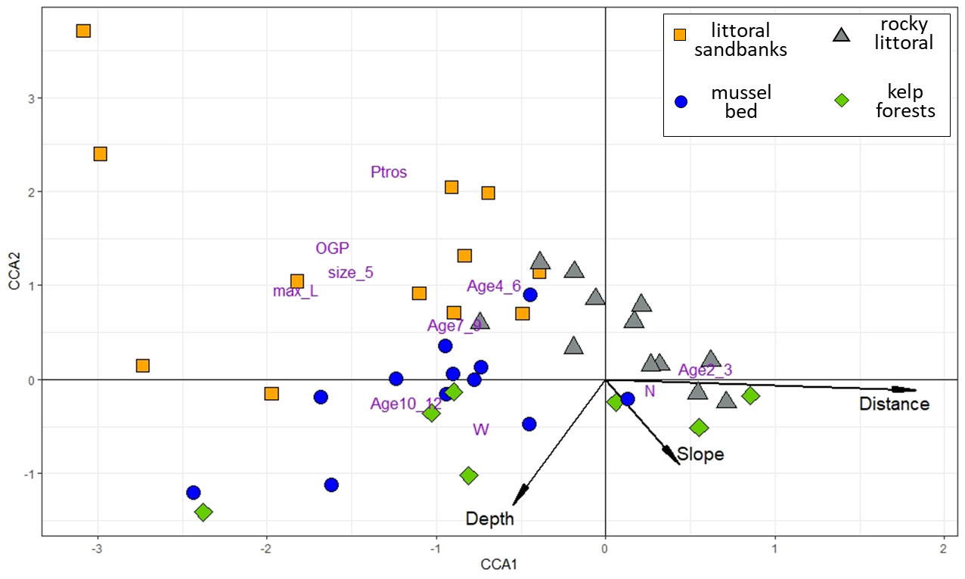
Река Тюва
каменистая литораль
сообщество ламинариевых водорослей
илисто-песчаные отмели
мидиевая банка
до
 | Estemate | SE | z-statistic | p-value
Intercept | -0.25145 | 0.10889 | -2.309 | 0.02
Depth | -0.34771 | 0.08205 | -4.238 | < 0.001
Exposition | -0.51392 | 0.17405 | -2.953 | 0.003
Distance | 0.18086 | 0.08505 | 2.127 | 0.03
Cover_algae | 0.18613 | 0.09166 | 2.031 | 0.04

Slide 3
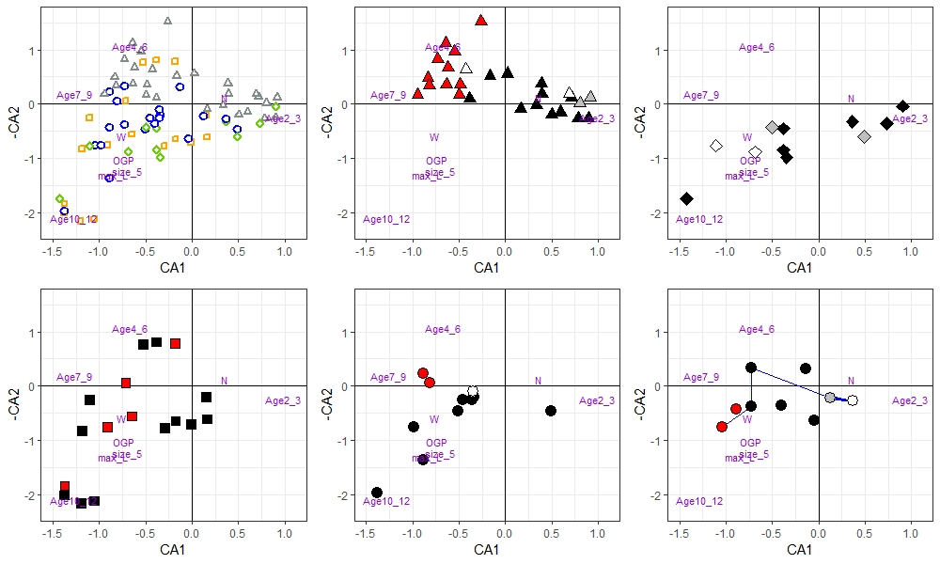
rocky littoral
kelp
forests
littoral sandbanks
mussel bed
sublittoral part
mussel bed
littoral part
ПП: Fig. Correspondence Analysis (CA) plot based on demographic characteristics of mussel settlements in all surveys (data for the same settlements for different years are considered independently). CA1 explains ??%, CA2 - ??% of variance. (A) Original plot, signs are settlements, settlements from different habitats are depicted as on Fig. ?; ordination of demographic characteristics is shown by abbreviated names. B-F. Graphs identical to that on (A), but some of the points are hidden to show temporal changes in the settlements from certain habitats (B – Rocky littoral, C - Kelp forests, D – littoral sandbanks, E – sublittoral part of mussel bed, F - littoral part of mussel bed). The intensity of the color fill reflects the time period of sampling. The arrows on ?. show temporal changes in BS+05 studied in 2005, 2009, 2010, 2012, and 2018. /(The arrows indicate temporal changes in the settlements studied more than twice).

